Slide 1
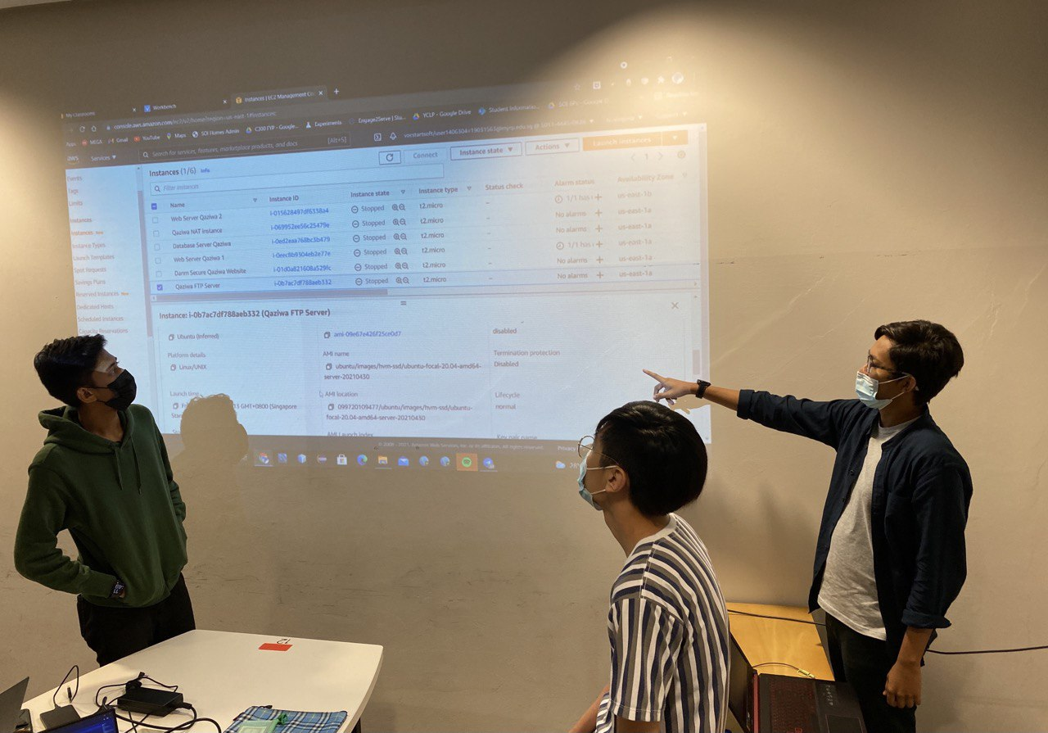
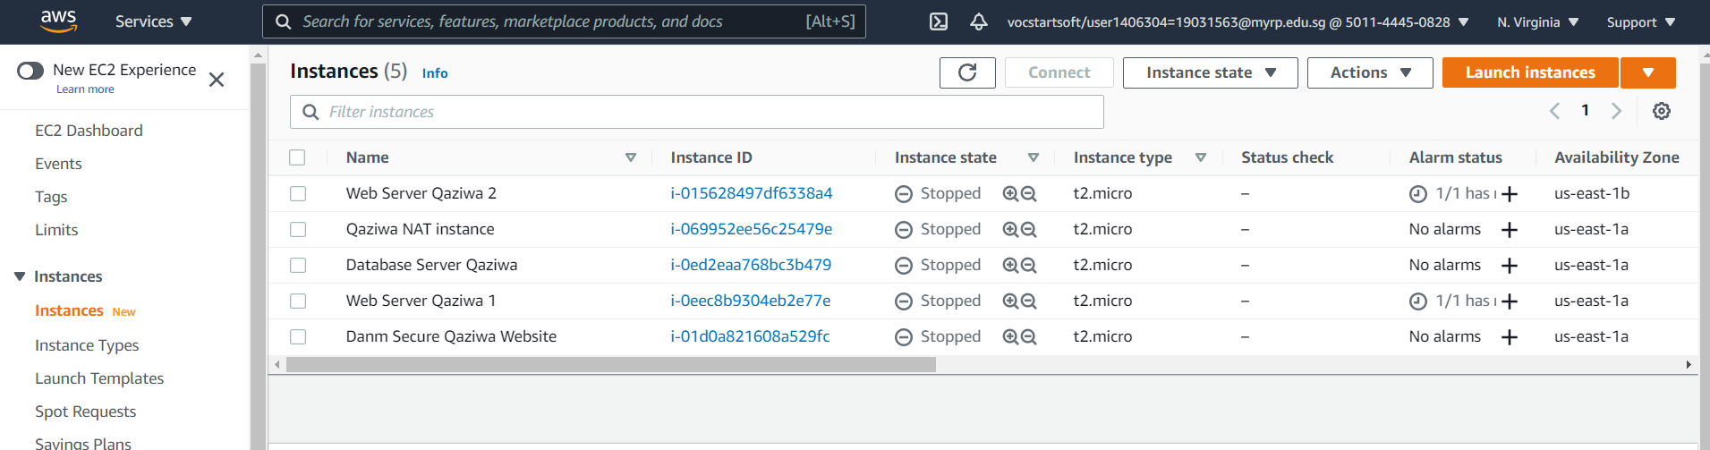
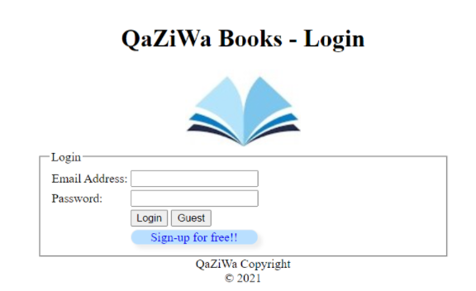
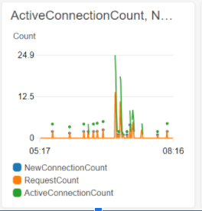
Implementation of Security Infrastructure on the Cloud
Project Overview
Problem: In this day and age, web application is a widely used platform providing many services in the hopes of providing services in the comfort of the users home. Companies nowadays are attracted to cloud computing more specifically its on-demand and elastic nature. With the cloud structure being demanded there would be a need to support its adoption more accurately aiding in the securing of the cloud structure. Having cloud security allows the organization to host their web applications securely and free of worry from malicious attackers.
Requirements: The project has us deploying a created 2 tier architecture on the a Virtual Private Cloud (VPC) in AWS. Data for both in transit and at rest are configured for secure connection with security groups implemented to restrict any unnecessary ports. Auto scaling and Application Load Balancing would also be used to manage the traffic frequency in the event there is an influx in users. Monitoring would also be required through the use of the CloudWatch and CloudTrail service to be notified of anomalies in the VPC.
Solution: The team has created a E-commerce book store, Qaziwa. The data that is used and stored by Qaziwa are stored in a MySQL database and implemented along with the website into respective instances in our created VPC. The team has implemented encryption for all data that is in-transit and at rest with the traffic heavily restricted only allowing the traffic HTTPS, SQL and essential ports open. For the users of the website, we have implemented Google Authenticator as a form of identity authentication to prevent malicious users impersonating as a user.
Technologies: AWS Classroom (Cloud Service), Putty, Netbeans IDE. (PHP, Javascript, CSS and HTML), phpMyAdmin, Cloudflare, Linux OS, AWS CLI, Freenom (Domain name System), Google Authenticator
Instance Dashboard which hosts the team’s Web App and Database Server
Team Members
Team leader: Muhd Wafiyuddin Bin Abdul Rahman
Member: Ng Zi Rui
Member: Qamarrul Danial Bin Razali
Supervisor: Ms. Pauline Chin
Team’s created website hosted through AWS Classroom
Notes:
NOTES
Refer to write ups in ‘Past Projects for Reference’ Booklet for Project overview write ups - http://intranet.rp.edu.sg/soi/students/SOI%20Module%20Resources/Project.aspx
ENGLISH - British E.g. organisation VS organization
Font: RP approved font - Arial family only.
Header: Arial Bold
Copy text: Arial regular or Arial Bold. Use Emphasis of our SOI orange in moderation.
Picture frame – Give a 4.5 or 6pt orange outline.

